Slide 1


Public Employees Insurance Program
Group Online Premium Payment
We encourage all payors to use the online payment system. We hope you find these instructions helpful in setting up your payments.
If you have any problems with the process, please call us at 952-746-3106.

Slide 2
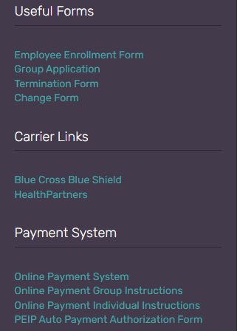
Accessing the Premium Payment Site
To access out online premium payment site, first visit the Innovo Benefits website.
https://innovomn.com/employeeplan.php
On the right-hand side of the screen, you will find the Payment System tab. Clicking the Online Payment System tab will bring you to our online premium payment portal.
https://www.billerpayments.com/app/simplepayui/?bsn=smnpeip#/simplepay/payment

Slide 3
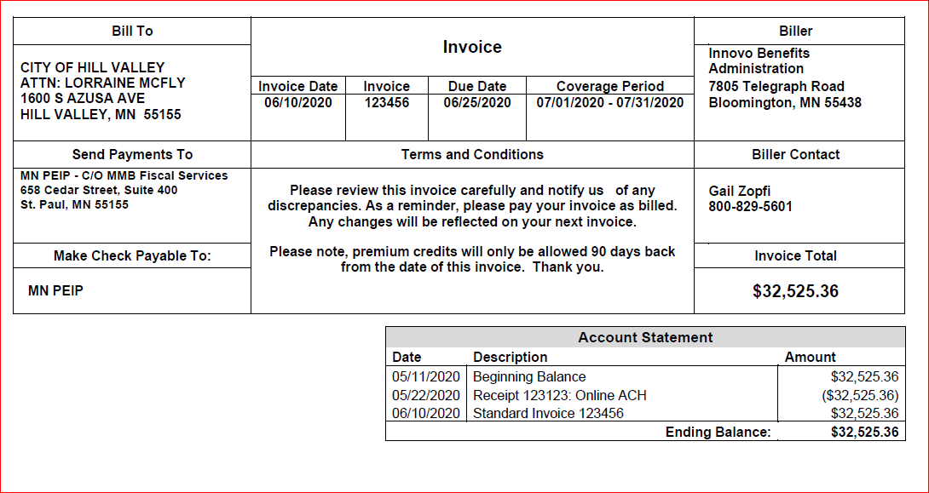
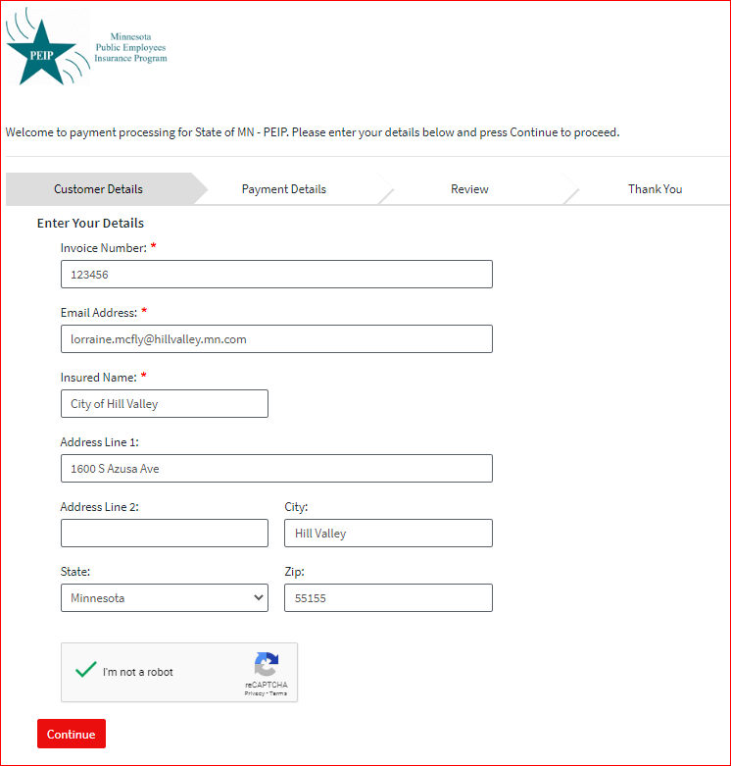
Entering Invoice Data: Customer Details
Once on the online premium payment site you will use your invoice to fill in the appropriate fields.

Slide 4
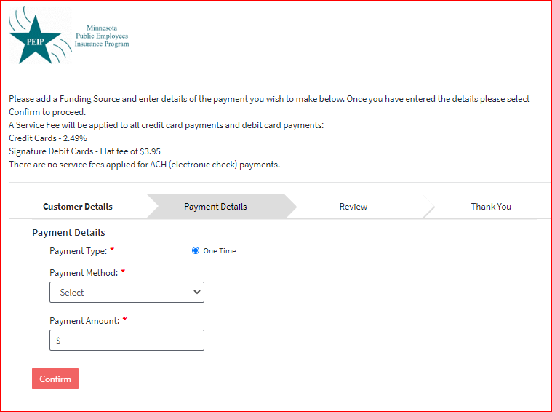
Entering Invoice Data: Payment Details
Use the drop-down to select either ‘New Bank Account’ (for an ACH payment), or ‘New Card Account’ (for a credit card or debit card payment)

Slide 5
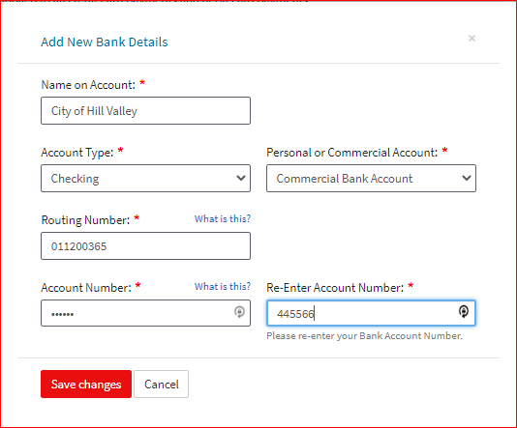
After selecting your payment type, please enter your account information.
Entering Invoice Data: Bank Details

Slide 6
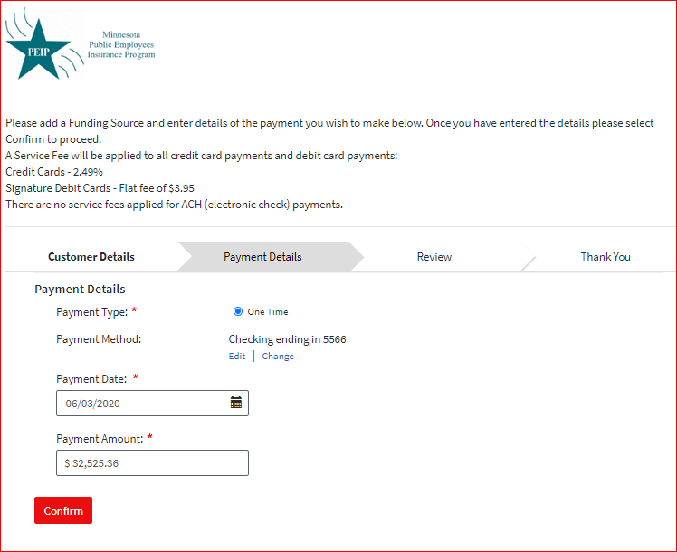
Entering Invoice Data: Payment Details
Enter the date on which you want the payment made and the amount you want to pay.

Slide 7
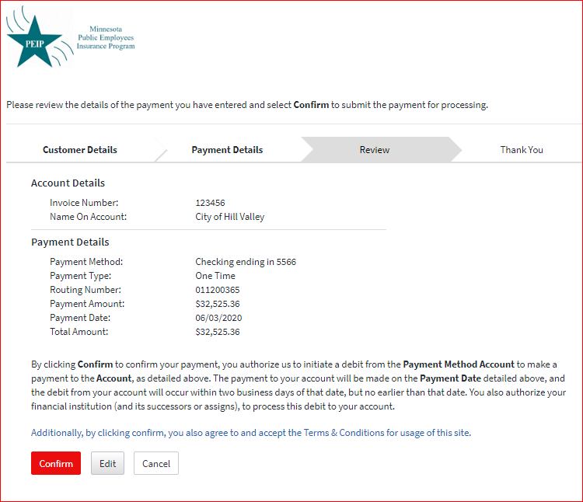
Entering Invoice Data: Review Payment
Review payment details, then click ‘Confirm’ to make the payment, ‘Edit’ to make any changes, or ‘Cancel’

Slide 8
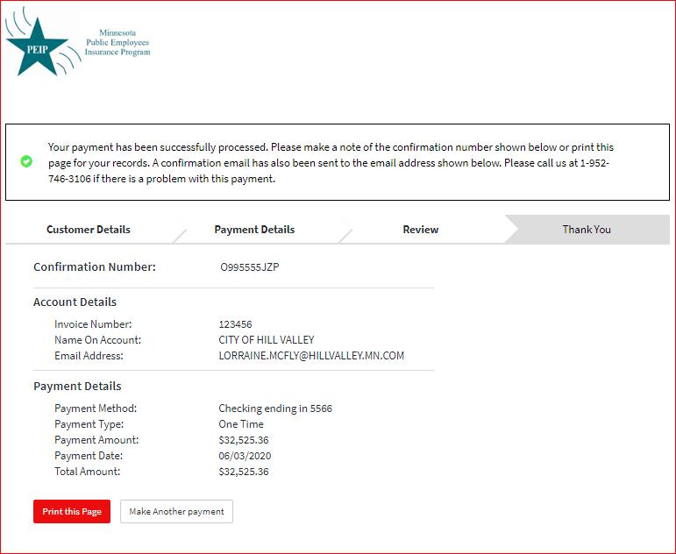
Entering Invoice Details: Confirmation
The last page shows the details of the payment. You may print or save the page. An email with the payment details will be sent to the email address entered on the first screen.

