Slide 1

WELCOME retirees!
Public employees insurance program
2026 Group Medicare Plans
Lori Hart, Group Medicare Account Executive
Friday, October 31, 2025
Blue Cross® and Blue Shield® of Minnesota and Blue Plus® are nonprofit independent licensees of the Blue Cross and Blue Shield Association. We do not offer every plan available in your area. Any information we provide is limited to those plans we do offer in your area.
Please visit medicare.gov or call 1-800-MEDICARE to get information on all your options.

Slide 2


TODAY’S TOPICS
Medicare basics: Original Medicare overview
Group Medicare coverage for Public Employees Insurance Program retirees
2026 renewal updates and rates
Enrollment process
Useful resources
Questions
]

Slide 3

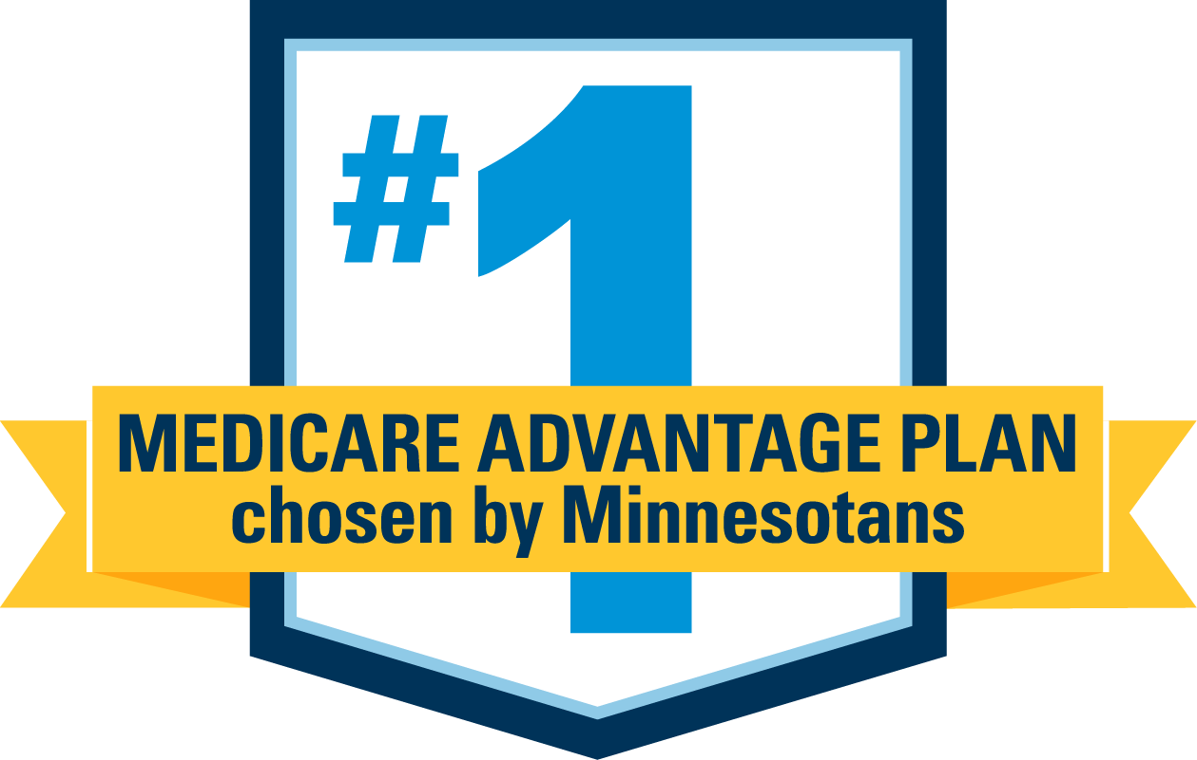




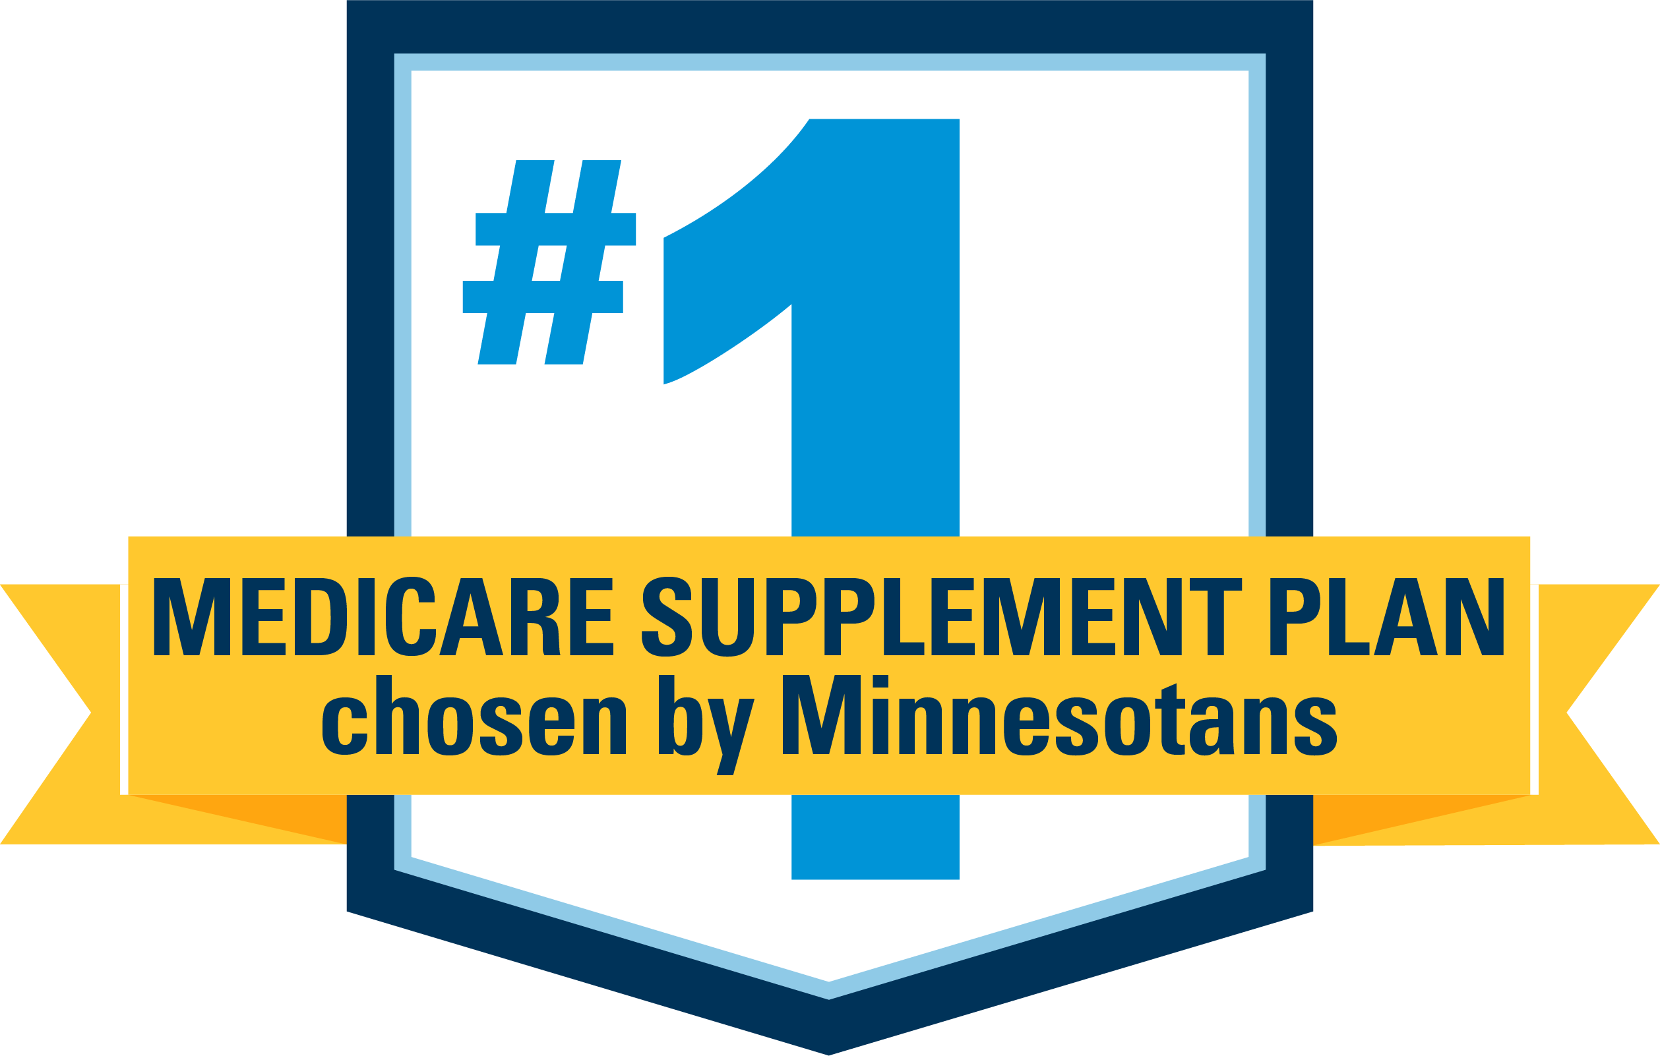

The value of Blue
Access to 98% of doctors in Minnesota³
¹
Top-rated by members for Medicare customer service⁴
Local expertise supporting Medicare since it began⁵
¹
For more than a century, serving Minnesota as a nonprofit⁶
²

Slide 4
PUBLIC EMPLOYEES INSURANCE PROGRAM
GROUP MEDICARE COVERAGE
GROUP MEDICARE PLAN OPTIONS
MEDICARE ADVANTAGE PLANS | MEDICARE COST PLANS | PART D PRESCRIPTION DRUG COVERAGE
Group Medicare Advantage Select Rx 2 Plan (MAPD) (Integrated medical and prescription drug) | Group Platinum Blue Plan C (Cost) | Group MedicareBlue Rx (PDP) Choice of Part D drug plans: Option 1: $10/$25/$60/25% Option 2: $5?410/20%/40%/33%

Slide 5


GROUP MEDICARE ADVANTAGE
Eligibility requirements
  RETIREE
  Be identified as an eligible plan participant by your employer
  Be entitled to Medicare Part A and enrolled in Medicare Part B
  Continue to pay Part B premium
  Must be a permanent resident of the
  United States or United States territories
  EMPLOYER GROUP / UNION
  Must be headquartered in Minnesota

Slide 6

GROUP MEDICARE ADVANTAGE
Plan highlights
Access to 98% of doctors in Minnesota*
National provider access to any Medicare-contracted provider that accepts Medicare assignment
Extras and options not covered by Medicare
No referrals needed
Worldwide emergency and urgent care benefits
Annual contract plans
*Medicare-contracted doctors compared to internal Blue Cross and Blue Shield of Minnesota data, April 2024. Some network limitations may apply.

Slide 7












MEDICARE ADVANTAGE
Plan extras
MEDICARE ADVANTAGE
  PHYSICAL EXAM
  $0 for one annual exam
  DENTAL
  Preventive dental
  OVER-THE-COUNTER
  $50 quarterly allowance for eligible over-the-counter purchases*
  DIABETES PREVENTION
  Virtual diabetes and heart disease prevention with online education, health coaching and peer groups
  HEARING
  $0 copay on exams, $499 copay (Advanced Aid), $799 copay (Premium Aid) per hearing aid
  VISION
  $0 copay for 1 routine exam plus $200 annual eyewear benefit for non-Medicare-covered eyewear
  SILVERSNEAKERS®
  50+ fitness classes and on-demand workout videos, workshops and online classes — all at no additional cost
  MEALS
  28 meals provided at no additional cost after an approved inpatient stay: 2 per day for 14 days
  CHIROPRACTIC
  12 routine visits; any diagnosis (X-ray excluded)
  ACUPUNCTURE
  12 routine visits for pain
  PEER SUPPORT SPECIALIST
$0 copay for substance use or mental health challenges
*Quarterly balance does not carry over.
SilverSneakers® is a registered trademark of Tivity Health, Inc., an independent company that provides health and fitness programs.
Notes:
Includes preventive dental

Slide 8
GROUP MEDICARE ADVANTAGE SELECT (MAPD-PPO)
MEDICARE ADVANTAGE
 | GROUP MEDICARE ADVANTAGE SELECT
Prescription drug option | Rx Option 2
Medical deductible | $0
Annual out-of-pocket maximum | $3,000 in-network
Office visit (primary care) | $0
Specialist visit | $20 copay
Preventive services* | $0
Inpatient hospital | $150 copay per stay
Emergency | $50 copay
Urgent care | $20 copay
Outpatient hospital surgery | $150 copay
Diabetic supplies (test strips and meters through Ascensia) | $0

Slide 9
GROUP MEDICARE ADVANTAGE
Rx Option 2
MEDICARE ADVANTAGE
RX OPTION 2
PAIR WITH MEDICAL PLAN: CLASSIC, SELECT, OR PREMIER | 31-day Supply from a Network Pharmacy or 31-day Supply from a Long-Term Care Facility | 90-day Supply from a Network Pharmacy or Mail Order
Prescription drug deductible | $0 | $0
Tier 1: Preferred generic drugs | $0 | $0
Tier 2: Generic drugs | $10 copay | $20 copay
Tier 3: Preferred brand drugs | $25 copay | $50 copay
Tier 4: Non-preferred drugs | $60 copay | $120 copay
Tier 5: Specialty drugs | 25% coinsurance | 25% coinsurance
Catastrophic coverage Amount you pay after annual out-of-pocket prescription drug costs reach $2,100 | During this payment stage, the plan pays the full cost for your covered Part D drugs. You pay nothing. For excluded drugs covered under our Bonus drug list, you pay 25% coinsurance.
Bonus drug coverage | 25% coinsurance | 25% coinsurance

Slide 10
IF YOUR DRUG IS NOT ON THE FORMULARY
  TALK WITH YOUR DOCTOR
  Your doctor can review the formulary and prescribe a similar drug for your condition.
  REQUEST A
  FORMULARY EXCEPTION
  If other drugs won’t be as effective, your doctor can ask the plan to cover the drug.
  REQUEST A
  TRANSITION SUPPLY
  You can request up to a 31-day transition supply during your first 90 days of membership.

Slide 11
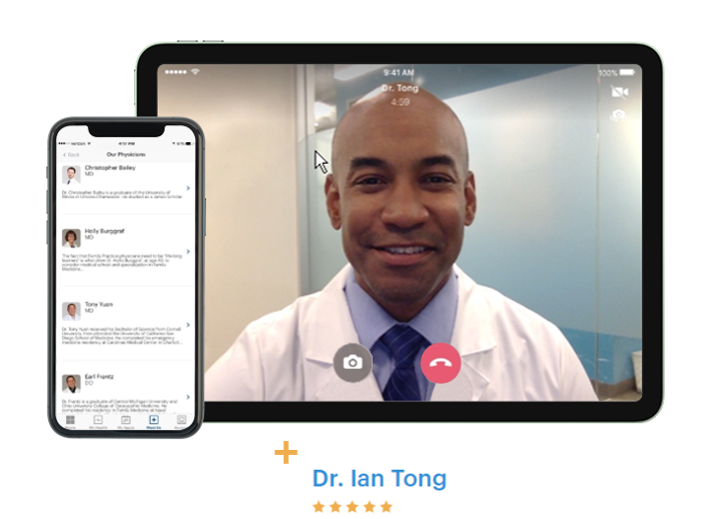

DOCTOR ON DEMAND®
MEDICARE ADVANTAGE
Video chat with a doctor, psychologist or psychiatrist via your smartphone, tablet
or computer
Board-certified doctors available
24 hours a day, 365 days a year
Specialist / primary care copay applies, based on care provided
Z
  doctorondemand.com/BlueCrossMN

Slide 12


SilverSneakers
New enrichment classes via GetSetUp
RESOURCES
MEMBERS JOIN PEERS FOR LIVE DIGITAL CLASSES
Learn new skills, unlock new life experiences and continue life-long learning.
Learning platform is designed specifically for older adults to combat social isolation and cognitive decline.
SilverSneakers® platform includes thousands of online classes covering health and wellbeing, self-help, technology, brain fitness and more.
Instructors encourage active participation to ensure
each member is engaged, learning and unlocking new
life experiences.
  Accessed via the silversneakers.com member portal

Slide 13

GROUP MEDICARE ADVANTAGE MEMBER RESOURCES
MEDICARE ADVANTAGE
  ONLINE
  Visit bluecrossmn.com to:
  View claim history
  Find in-network doctors
  and hospitals
  Find quality ratings for doctors and other providers
  Send secure emails to
  Customer Service
  CUSTOMER SERVICE
  Call 1-800-711-9865 (TTY 711)
  Monday through Friday,*
  8 a.m. to 8 p.m. Central Time

Slide 14

QUESTIONS ABOUT GROUP MEDICARE ADVANTAGE?

Slide 15
GROUP PLATINUM BLUESM
Eligibility requirements¹
PLATINUM BLUE
  RETIREE
  Have Medicare Part A and/or Part B
  Continue to pay Part B premium
  Be a permanent resident of Minnesota
  Reside in plan’s service area
  EMPLOYER GROUP / UNION
  Must be headquartered in Minnesota

Slide 16
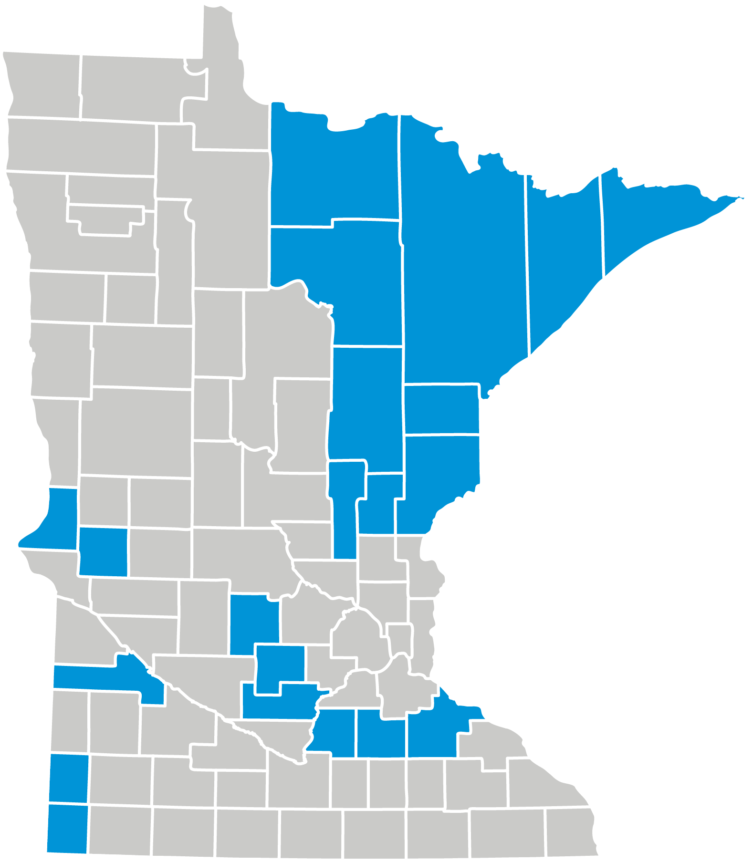
GROUP PLATINUM BLUE
Plan highlights
PLATINUM BLUE
FEATURES OF THIS PLAN
  Extras not covered by Medicare
  Large access network (statewide and U.S.)
  No referrals needed
  Nationwide travel up to nine consecutive months and access to
  in-network providers and prescription support
  Worldwide emergency benefits
  Annual contract plan

Slide 17
GROUP PLATINUM BLUE (COST)
Availability area: Counties in Minnesota
PLATINUM BLUE
Aitkin
Carlton
Cook
Goodhue
Itasca
Kanabec
Koochiching
Lake
Le Sueur
McLeod
Meeker
Mille Lacs
Pine
Pipestone
Rice
Rock
Sibley
St. Louis
Stevens
Traverse
Yellow Medicine

Slide 18


GROUP PLATINUM BLUE
Plan extras
PLATINUM BLUE
  PHYSICAL EXAM
  $0 for one annual exam
  OVER-THE-COUNTER
  $50 per quarter allowance for eligible over-the-counter purchases*
  VISION
  $0 copay for 1 routine exam plus $200 annual eyewear benefit for non-Medicare-covered eyewear
  HEARING
  $0 copay on exams, $499 copay (Advanced Aid);
  $799 copay (Premium Aid) per hearing aid
  DIABETES PREVENTION
  Diabetes and heart disease prevention with online education, health coaching and peer groups
  SILVERSNEAKERS®
  Fitness program: 600+ participating locations in Minnesota, virtual classes
  CHIROPRACTIC
  12 routine visits; any diagnosis (X-ray excluded)
  ACUPUNCTURE
  12 routine visits for pain
*Quarterly balance does not carry over.
SilverSneakers® is a registered trademark of Tivity Health, Inc., an independent company that provides health and fitness programs.

Slide 19


GROUP PLATINUM BLUE
Plan C medical coverage
BENEFITS | COST
Deductible | $0
Office visits | $20 copay
Preventive services | $0
Inpatient hospital care | $200 copay per stay
Emergency | $50 copay
Urgent care | $20 copay
Durable medical equipment (DME) | 20% coinsurance
Over-the-counter benefit* | $50 per quarter
Annual out-of-pocket maximum | $3,000

Slide 20
GROUP PLATINUM BLUE MEMBER RESOURCES
  ONLINE
  Visit bluecrossmn.com to:
  View claim history
  Find in-network doctors
  and hospitals
  Find quality ratings for doctors and other providers
  Send secure emails to
  customer service
  CUSTOMER SERVICE
  Call 1-866-340-8654 (TTY 711) Monday through Friday,*
  8 a.m. to 8 p.m. Central Time

Slide 21

QUESTIONS ABOUT
GROUP PLATINUM BLUE?

Slide 22
GROUP MEDICAREBLUESM RX (PDP)
Eligibility requirements
  RETIREE
  Be identified as an eligible plan participant by your employer
  Be entitled to Medicare benefits under Part A
  and/or enrolled in Medicare Part B
  Continue to pay your Part B premium
  Live in the plan’s service area
  You are a U.S. citizen or lawfully present
  in the U.S.
  Please note: May only be enrolled in one Part D plan at any time
  EMPLOYER GROUP / UNION
  Must be headquartered in Minnesota
Notes:
8/5 - LN – no changes.

Slide 23

GROUP MEDICAREBLUE RX
Prescription drug coverage
FEATURES
Stand-alone Medicare Part D plan
Helps pay for generic and brand-name drugs
Includes some coverage for supplemental drugs
Offers a 90-day supply for two copayments when applicable
Fill your prescription at participating network pharmacies across the U.S., including independent pharmacies, national chains and more
No deductible
The formulary meets federal regulations. ​
Supplemental drug coverage includes select drugs excluded from the Medicare Part D program.​
Notes:
8/5: Worked with Lanette and Becky on this slide – still in progress

Slide 24
GROUP MEDICAREBLUE RX
$10 / $25 / $60 / 25%: Option 1
 | 30-day Supply from a Network Pharmacy or 31-day Supply from a Long-Term Care Facility | 90-day Supply from a Network Pharmacy or Mail Order
Tier 1: Generic drugs | $10 copay | $20 copay
Tier 2: Preferred brand drugs | $25 copay | $50 copay
Tier 3: Non-preferred brand drugs | $60 copay | $120 copay
Tier 4: Specialty drugs | 25% coinsurance | 25% coinsurance
Catastrophic coverage Amount you pay after annual out-of-pocket prescription drug costs reach $2,100 | During this payment stage, the plan pays the full cost for your covered Part D drugs. You pay nothing. For excluded drugs covered under our Supplemental drug list, you pay 25% coinsurance.
Supplemental drugs* | 25% coinsurance | 25% coinsurance

Slide 25
GROUP MEDICAREBLUESM RX
$5/$10/20%/45%/33%: Option 2
 | 30-day Supply from a Network Pharmacy or 31-day Supply from a Long-Term Care Facility | 90-day Supply from a Network Pharmacy or Mail Order
Tier 1: Preferred Generic drugs | $5 copay | $10 copay
Tier 2: Generic drugs | $10 copay | $20 copay
Tier 3: Preferred brand drugs | 20% coinsurance | 20% coinsurance
Tier 4: Non-Preferred drugs | 45% coinsurance | 45% coinsurance
Tier 5: Specialty drugs | 33% coinsurance | 33% coinsurance
Catastrophic coverage Amount you pay after annual out-of-pocket prescription drug costs reach $2,100 | During this payment stage, the plan pays the full cost for your covered Part D drugs. You pay nothing. For excluded drugs covered under the Supplemental drug list, you pay 25% coinsurance.
Supplemental drugs* | Not covered | Not covered

Slide 26
IF YOUR DRUG IS NOT ON THE FORMULARY
  TALK WITH YOUR DOCTOR
  Your doctor can review the formulary and prescribe a similar drug for your condition.
  REQUEST A
  FORMULARY EXCEPTION
  If other drugs won’t be as effective, your doctor can ask the plan to cover the drug.
  REQUEST A
  TRANSITION SUPPLY
  You can request up to a 30-day transition supply during your first 90 days of membership.

Slide 27


GROUP MEDICAREBLUESM RX
Diabetic supply coverage
  PART B MEDICAL INSURANCE
  Strips
  Machines
  Calibration solutions
  Lancets
  PART D PRESCRIPTION DRUG BENEFIT
  Syringes
  Insulin
  Needles
  Alcohol swabs

Slide 28
GROUP MEDICAREBLUESM RX MEMBER RESOURCES
  ONLINE
  Visit YourMedicareSolutions.com/
  GroupPlans to see:
  Forms
  Formulary
  Pharmacy locator
  CUSTOMER SERVICE
  Call 1-877-838-3827 (TTY 711)
  daily, 8 a.m. to 8 p.m.* Central and Mountain Time
*We are available seven days a week October 1 through March 31 and available Monday through Friday the rest of the year.

Slide 29

QUESTIONS ABOUT GROUP MEDICAREBLUE RX?

Slide 30
IRA of 2022 CHANGES CONTINUE INTO 2026
In 2026, members will have a $2,100 out-of-pocket cap on covered Part D drugs
Medicare will negotiate drug prices for the first time
2023
2024
2025
2026
2027
2028
2029
Requires drug companies to pay rebates if drug prices rise faster than inflation | Eliminates 5% coinsurance for Part D catastrophic coverage | Adds $2,000 out-of-pocket cap in Part D and other drug benefit changes | Implements negotiated prices for certain high-cost drugs:
 |  |  | 10 Medicare Part D drugs | 15 Medicare Part D drugs | 15 Medicare Part B and Part D drugs | 20 Medicare Part B and Part D drugs
Limits insulin copays to $35/month in Part D | Expands eligibility for Part D Low-Income Subsidy full benefits up to 150% FPL | Allows spreading out of OOP costs over the year
$0 cost share for adult Part D vaccines |  | Coverage gap removed
2024 - 2030: Limits Medicare Part D premium growth to no more than 6% per year
Source: Kaiser Family Foundation, Explaining the Prescription Drug Provisions in the Inflation Reduction Act | KFF

Slide 31
2026 UPDATES: GROUP MEDICARE ADVANTAGE PLANS
Benefit | Plan(s) affected | Current benefit | 2026 benefit
OP Hospital Services | Select (MAPD) | $75 | $150
OP Observation Visit | Select (MAPD) | $25 | $150
Ambulatory Surgical Center | Select (MAPD) | $75 | $100
Telehealth | All MA and MAPD plans | Covered per public health emergency | Additional plan benefit
Part D catastrophic coverage threshold (Determined by Inflation Reduction Act) | All MAPD Plans | $2,000 | $2,100
Notes:
Matt

Slide 32
2026 Group Medicare Renewal
PUBLIC EMPLOYEES INSURANCE PROGRAM
Group Medicare Advantage Select Rx 2 MAPD (PPO) | 2025 | 2026
T Total monthly premium per member | $280.00 | $289.50

Slide 33
2026 Group Medicare Renewal
PUBLIC EMPLOYEES INSURANCE PROGRAM
Group Platinum Blue Plan C with Group MedicareBlue Rx (PDP) | 2025 | 2026
Group Medicare Platinum Blue Plan C | $118.50 | $132.50
Group MedicareBlue RX (PDP) $10/$25/$60/25% | $203.50 | $249.50
Total monthly premium per member | $322.00 | $382.00
Group Platinum Blue Plan C with Group MedicareBlue Rx (PDP) | 2025 | 2026
Group Medicare Platinum Blue Plan C | $118.50 | $132.50
Group MedicareBlue RX (PDP) $5/$10/20%/45%/33% | $175.00 | $216.00
Total monthly premium per member | $293.50 | $348.50

Slide 34
2026 MEDICARE RENEWAL COMMUNICATIONS
TYPE | WHEN | RETIREE WILL RECEIVE
Medical Group Medicare Advantage (PPO) medical with Part D coverage, Group Platinum Blue (Cost) | 15 days prior to either your Open Enrollment start date or your next plan year effective date | Annual Notice of Changes Important Plan Documents flyer with applicable information on how to locate the Evidence of Coverage, Provider Directory, Pharmacy Directory, Formulary
Prescription drug Group MedicareBlue Rx (PDP) | 15 days prior to either your Open Enrollment start date or your next plan year effective date | Annual Notice of Changes Insert on how to obtain a Pharmacy Directory, Formulary and Evidence of Coverage Low-Income Subsidy (LIS) for qualifying members who receive Extra Help to pay for costs

Slide 35
GROUP ENROLLMENT PROCESS
  COMPLETE THE GROUP APPLICATION FORM
  Each Medicare-eligible employee and spouse must complete an application form.
  You may choose different plans.
  RETURN THE APPLICATION FORM(S)
  Return enrollment applications to Innovo Benefits Administration
  Once applications are processed, you will begin to receive post enrollment communications.
  MEDICAL ID CARDS
  New medical identification cards trigger around December 15, 2025.

Slide 36
OTHER USEFUL RESOURCES
BLUE CROSS AND BLUE SHIELD
OF MINNESOTA
  1-877-311-0404, TTY 711,
  8 a.m. to 8 p.m. Central Time, daily
  bluecrossmn.com
  YourMedicareSolutions.com
  bluecrossmn.com/Advisors
SENIOR LINKAGE LINE®
  1-800-333-2433
  TTY 711
  seniorlinkageline.com
SOCIAL SECURITY
  1-800-772-1213
  TTY 1-800-325-0778
  8 a.m. to 7 p.m., Monday through Friday
  ssa.gov
MEDICARE HELPLINE
  Seven days a week, 24 hours a day
  1-800-633-4227
  TTY 1-877-486-2048
  medicare.gov

Slide 37
QUESTIONS?

Slide 38
IMPORTANT INFORMATION
Blue Cross offers PPO, Cost and PDP plans with Medicare contracts. Enrollment in these Blue Cross plans depends
on contract renewal. This information is not a complete description of benefits. Call 1-877-662-2583 / TTY 711 for more information.
Each healthcare provider is an independent contractor and not our agent. It is up to the member to confirm provider participation in their network prior to receiving services.
Out-of-network/non-contracted providers are under no obligation to treat Blue Cross and Blue Shield of Minnesota Medicare plan members, except in emergency situations. Please call our Customer Service number or see your Evidence of Coverage for more information.
Blue Cross® and Blue Shield® of Minnesota and Blue Plus® are nonprofit independent licensees of the Blue Cross
and Blue Shield Association. Blue Cross, Blue Shield, and the cross and shield symbols are registered marks of the
Blue Cross and Blue Shield Association. Platinum Blue and Group MedicareBlue Rx are service marks of the Blue Cross and Blue Shield Association. Senior Gold is a service mark of Blue Cross and Blue Shield of Minnesota. Aware is a registered mark of Blue Cross and Blue Shield of Minnesota.
Prime Therapeutics LLC is an independent company providing pharmacy benefit management services.
Group MedicareBlueSM Rx (PDP) is a prescription drug plan with a Medicare contract. Enrollment in Group MedicareBlue Rx depends on renewal of the plan sponsor’s contract with Medicare. Coverage is available to members of an employer or union group and separately issued by one of the following plans: Wellmark Blue Cross and Blue Shield of Iowa;* Blue Cross and Blue Shield of Minnesota;* Blue Cross and Blue Shield of Montana,* a division of Health Care Service Corporation, a Mutual Legal Reserve Company; Blue Cross and Blue Shield of Nebraska;* Blue Cross Blue Shield of North Dakota;* Wellmark Blue Cross and Blue Shield of South Dakota;* and Blue Cross Blue Shield of Wyoming.*
*Independent licensees of the Blue Cross and Blue Shield Association.

Slide 39

THANK YOU.

